Slide 2
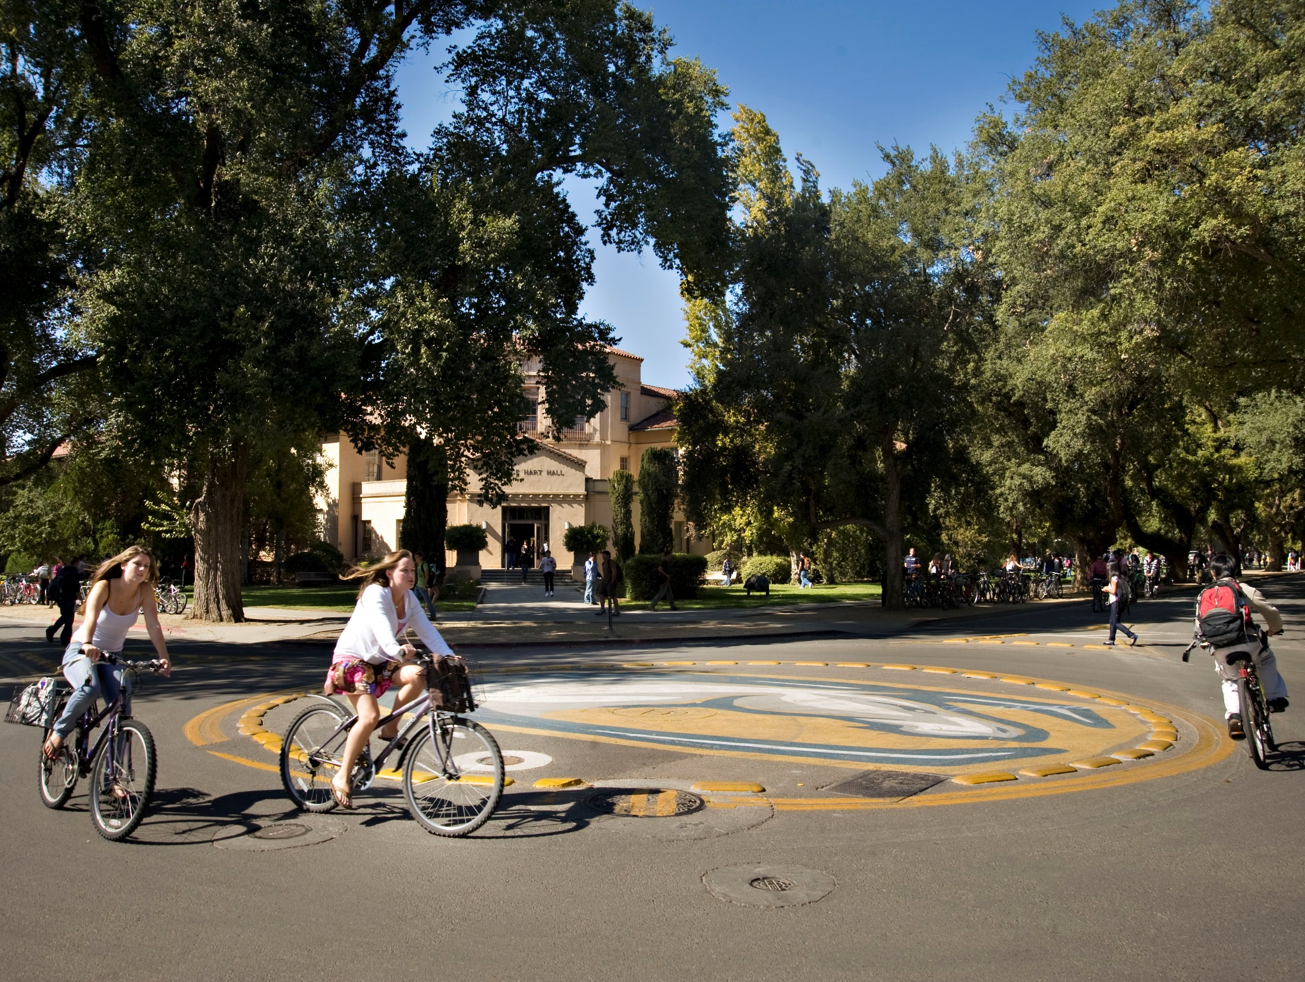
Over 21,000 bikes on campus each day
29,000 bike parking spaces
Over 22 miles of bike lanes and paths
25 roundabouts

Slide 3
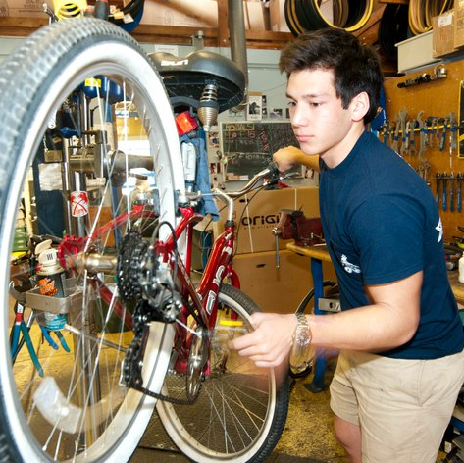
Does everyone have a bike?
Pretty much, yes
Buy a quality bike
Register your bike
ASUCD Bike Barn Bike Buy
Consider a service plan

Slide 4
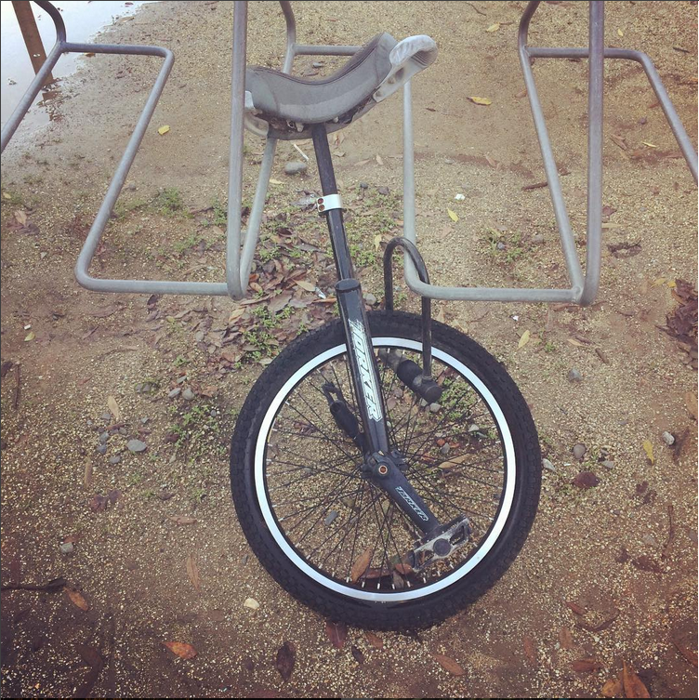
Will my bike get stolen?
With your help, no
Register your bike
Buy and use a quality lock
Only lock in bike parking areas

Slide 5
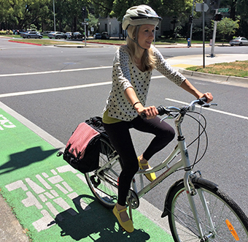
Absolutely, and we will help you learn how
Is it safe to ride?
Stay alert, be aware and ride predictably
Free bike safety class
Buy and wear a helmet

Slide 6
Free, online class:
BIKESAFETY.ucdavis.edu
UC Davis Bike Program:
530-752-BIKE (2453)
TAPS.ucdavis.edu/BICYCLE
City of Davis Bike Program:
GettingAroundDavis.org

