Slide 1
Student Accounting
Summer Orientation 2018

Slide 3
MyBill
Make a payment towards account balance
E-check
Credit Cards (All Major Credit Cards) – Coming Fall 2018
View payment history
Enroll in Deferred Payment Plan
Store payment methods for quick and easy payment

Slide 4
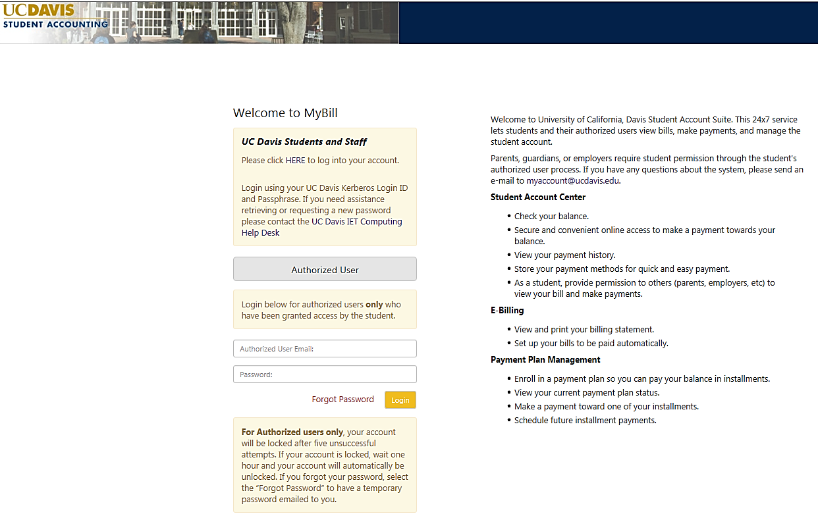
MBill

Slide 5
Authorized User Login

Slide 6
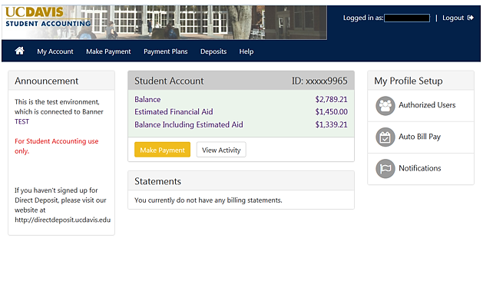
MyBill

Slide 7
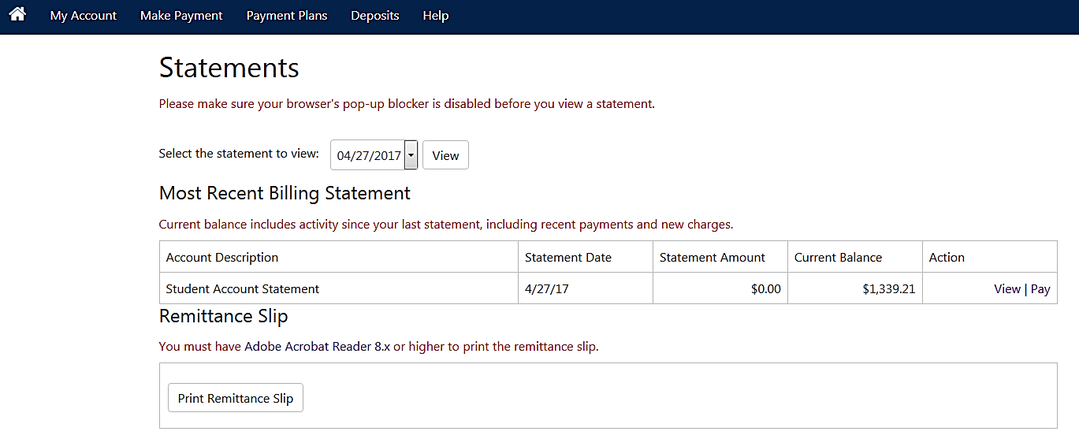
MyBill
View monthly billing statements
Statements are courtesy electronic billings that are issued on the 22nd of each month.
They are static and, therefore, do not reflect charges and payments made directly after that billing period.

Slide 8
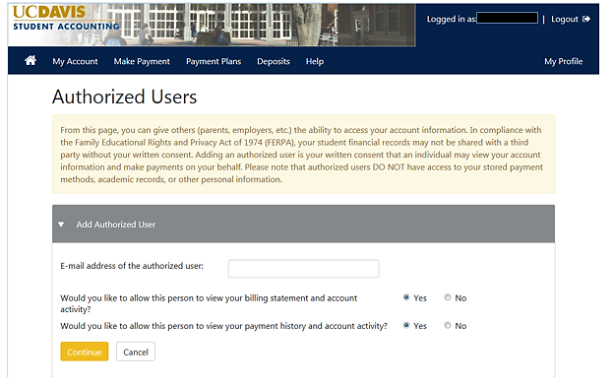
MyBill
Student can provide permission to others (parents, employers, etc.) to view their bill and make payments

Slide 9
Deferred Payment Plan (DPP)

Slide 10
Deferred Payment Plan (DPP)
DPP Plans
Annual – Only available until fee payment deadline of the Fall Quarter - Application Fee (includes Fall, Winter and Spring Quarters)
Quarterly – Available until fee payment deadline each quarter - Application Fee (must apply each quarter)
Summer - Available until fee payment deadline for each session - Application Fee Applies

Slide 11
Deferred Payment Plan (DPP)
DPP Enrollment Deadline for Fall Quarter
September 15, 2018
Fall quarter DPP installments due dates:
September 15th
October 15th
November 15th
A fee will be charge for each late payment

Slide 12
Charges eligible for the Deferred Payment Plan include:
Tuition Fees
Student Housing Fees
Health Insurance (SHIP)
Document Fee
Only students who owe at least $150 in tuition and qualifying fees after all discounts, financial aid, and other credits have been applied to their account can choose to defer payment.

Slide 13
Charges not eligible for the Deferred Payment Plan:
Orientation Fee
Course Material Fees
Previous Term Debt
Health Center Charges
Statement of Intent to Register Fee
Filing Fee
Library Fees
Bookstore Fees
Any other miscellaneous fees
Separate payments are needed for these charges

Slide 14
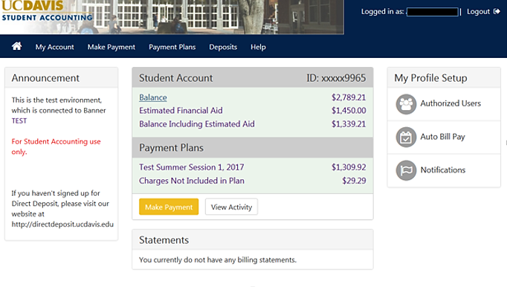

Slide 15
Student Financial Aid Refunds
Direct Deposit
http://directdeposit.ucdavis.edu
Paper Checks

Slide 16
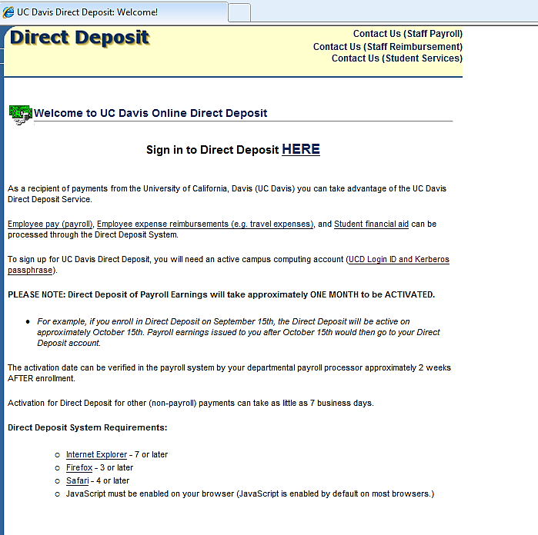
Direct Deposit Link https://accounting.ucdavis.edu/DirectDeposit/

Slide 17
1098 – T’s Available Online
my.ucdavis.edu
Changes coming for December 2018.
Students will be emailed information pertaining to their 1098-T

Slide 18
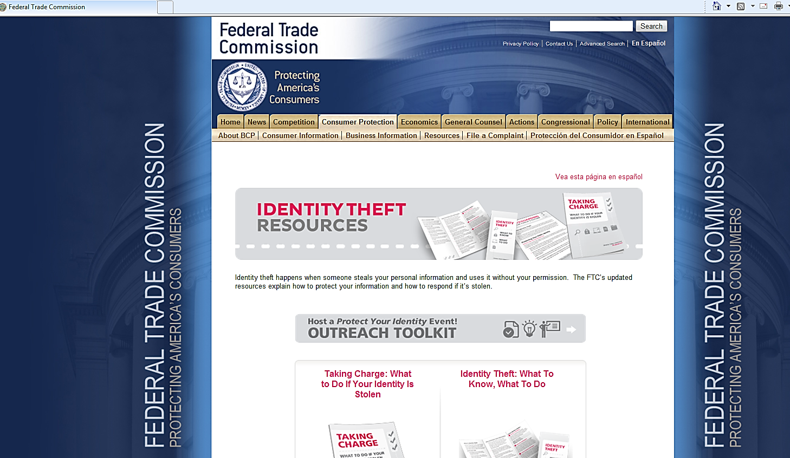
AVOID Theft Link
https://
s:/https://www.consumer.ftc.gov/features/feature-0014-identity-theft
/www.consumer.ftc.gov/features/feature-0014-identity-theft

Slide 19
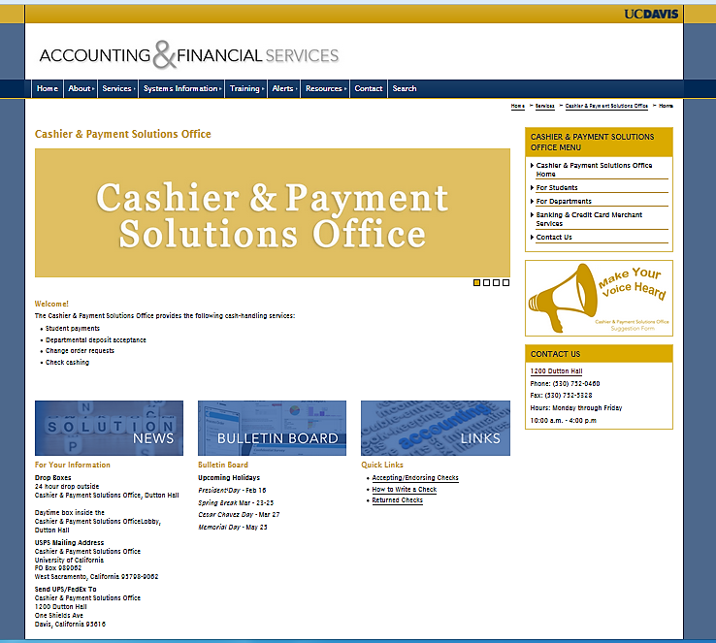
Cashier & Payment Solutions Office

Slide 20
Student Bill Payment Options All fees are due on the 15th of each month
In-Person
Payments can be delivered to the Cashier & Payment Solutions Office at 1200 Dutton Hall
By Mail (USPS)
Cashier & Payment Solutions Office University of California, Davis PO Box 989062 West Sacramento, California 95798-9062
Online / Electronic Payments
E-check – Free of charge
Credit Cards – 2.85% Service Charge – Starting Fall 2018

Slide 21
New MyBill Payment Options Coming this Fall
MyBill to accept all major credit cards
Transaction fee of 2.85% (minimum of $3)
Online only
e-check payments available free of charge
More information coming soon!

Slide 22
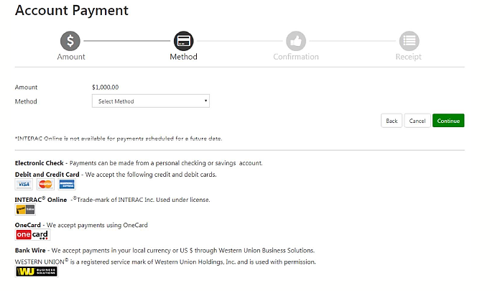
Student Bill Payment Options
Authorization for Credit Card Service Charge

Slide 23
Student Bill Payment Options Important Information
If you use your Debit Card as a credit card (Visa/MC logo) you will be charged the 2.85% service fee.
Credit Cards are not accepted in person or over the telephone. You can only use your credit card online thru MyBill.
Once you process your payment the 2.85% service fee will not be refunded.
Credit card payments cannot be cancelled once they are submitted.
Service Fee will not show on your student account. It will be a separate line item on your credit card statement.

Slide 24
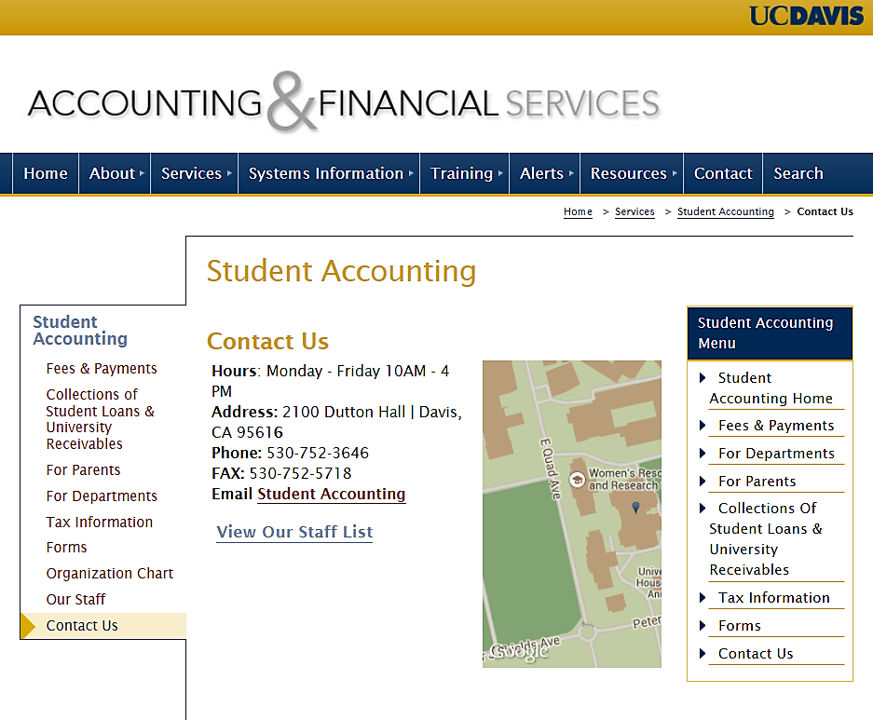

Slide 25
Thank You!

