Slide 1
Will you be career-ready?
We’re here to help - contact us today!
Internship and Career Center
530.752.2855 ∙ icc.ucdavis.edu
2nd & 3rd Floor, South Hall ∙ M-F, 10am-4pm

Slide 2
Connect with us
Drop-in Advising
10-15 minute advising session to get started
30 Minute Appointment
Sign up for ICC Email
Subscribe at: icc.ucdavis.edu/services/connect.htm to receive weekly updates
Meet with an advisor for in-depth questions
Schedule using Aggie Job Link

Slide 3
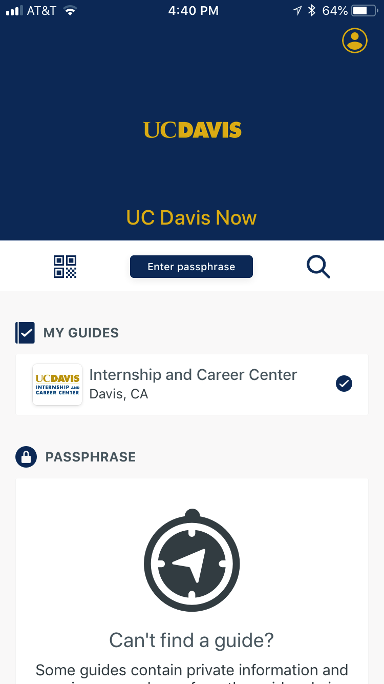
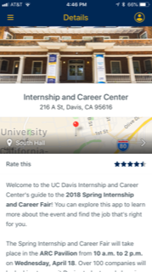
Download the App
UC Davis NOW
Calendar of events
Career Fair information
Connect with us on social media
Open the UC Davis Now app and download the ICC guide

