Slide 1
Transfer Orientation
Welcome
College of L&S Video
Undergraduate Education and Advising
Letters & Science Office of the Dean
Notes:
https://www.youtube.com/watch?v=hw_wLmDvuAo
Beth/Tracy/Brenna – welcome and congratulate the students and introduce Ari

Slide 2
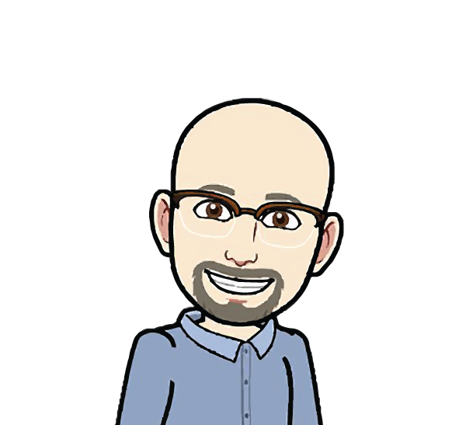
A Welcome from Professor Ari Kelman
Associate Dean of Undergraduate Programs and Planning
College of Letters and Science
Notes:
Ari Notes: Welcome. Congratulations. We are so glad you’re here. You’re supposed to be here. Imposter Syndrome. Tips for a successful transition.

Slide 3
Congratulations!
Notes:
Ari Notes: Welcome. Congratulations. We are so glad you’re here. You’re supposed to be here. Imposter Syndrome. Tips for a successful transition.

Slide 4
Meet & Greet Question
Turn to your neighbor and discuss: What is one goal you have for your first-year here?
Notes:
Beth/Tracy

Slide 5
Goals for Today:
Hear about our Advising Services
Learn about your Graduation Requirements
Write down some suggestions for Registration and how to have a Successful Fall Quarter
Notes:
Beth/Tracy
Some information about the college
Campus
Ask questions

Slide 6
L&S Advising Services
Assist you in shaping a meaningful educational experience
Advising is shared between
Undergraduate Education & Advising (UEA) in the Office of the Dean – 200 Social Science & Humanities Building - and
Administrative clusters/majors
Peer Advising in your Academic Advising Center
Faculty, professional staff, and peer advisors
Make an appointment online at appointments.ucdavis.edu
For assistance call (530) 752-0392
Notes:
Beth/Tracy
Academic Advising is central to the education of every UC Davis student
Academic Advisors guide students to access and use appropriate resources, tools and strategies to navigate this complex university
Faculty advisors are associated with each major and can help you understand the uniqueness or your major, discuss research opportunities in your field and assist with graduate school plans and career opportunities
Peer advisors are specially trained students that can help you with questions about courses and scheduling.

Slide 7
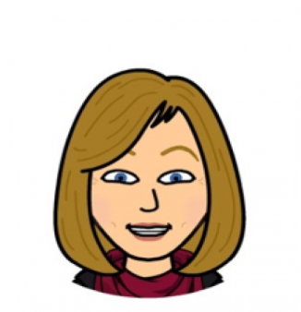
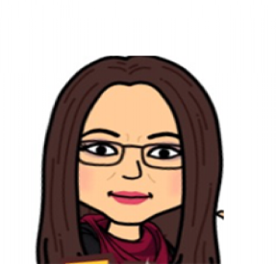
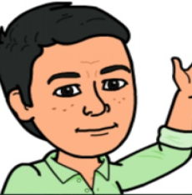
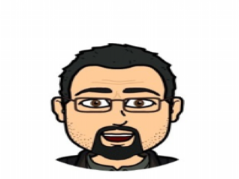
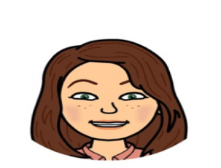
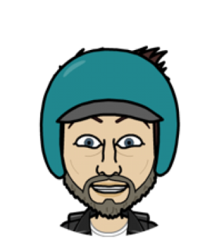
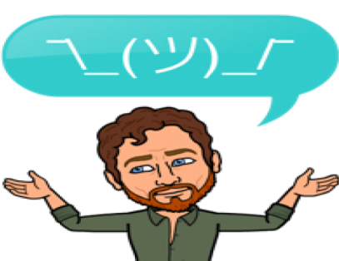
Undergraduate Education & Advising:
Leadership:
Ari Kelman,
Associate Dean
Beth Floyd,
Director
Tracy Grissom,
Assistant Director
Brenna Dockter,
First Year Transition
Coordinator
Letia Graening,
International Academic Advising
Coordinator
Assigned Domestic Academic Advisors:
Leo Alamillo
Lori Avellar
Kate Creveling
Jasmine Durias
Janet Gutierrez
Frances Gamez
Wendy Haws
Tess A. Lopez
Brighid O’Halloran
Mark Reyes
Sara Sweeney
Mike Valenzuela
Assigned International Academic Advisors:
Angie Applegate
John Clift
Kate Creveling
Jasmine Durias
Sarah Mooney
Andy Prettol
Notes:
Brenna/FYT

Slide 8
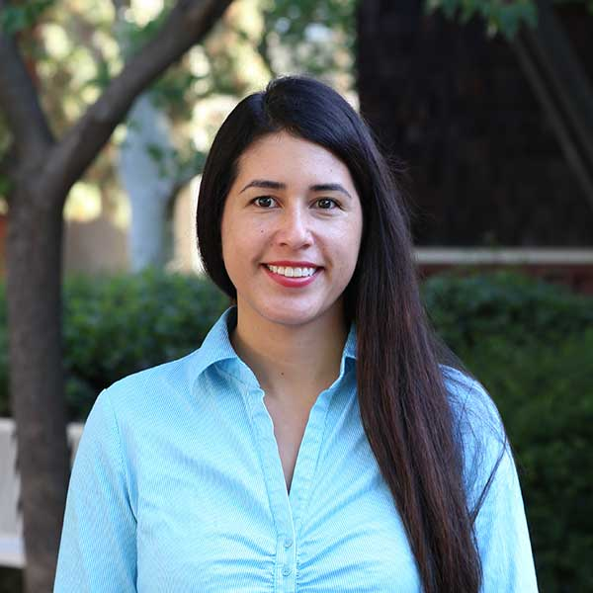
Student Health and Counseling Services: Your College Counselor
SHCS College Counselors provide individual counseling for students in specific colleges.
Adriana Torres, L.M.F.T.
atorres@shcs.ucdavis.edu
Office hours scheduled in UEA.
Notes:
Brenna/FYT
SHCS provides individual counseling services embedded in the Deans’ Office

Slide 9
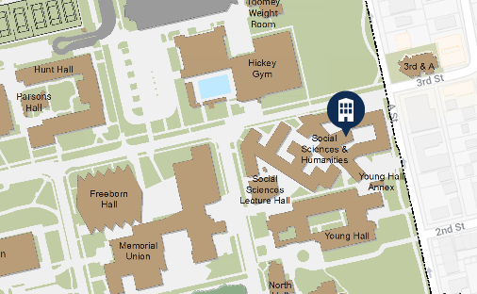
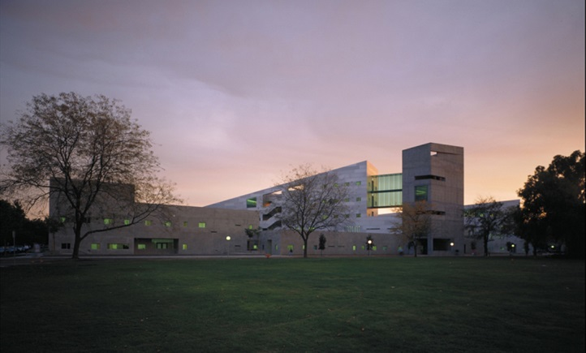
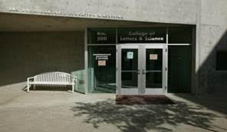
200 Social Sciences and Humanities Building
Notes:
Brenna/FYT

Slide 10
Mandatory Advising
This is a great chance for your academic advisors to get to know you, hear about your expectations and goals for college, and partner with you to support a great first year!
All students in L&S are required to meet with their major advisor during their assigned quarter in the 2018-19 year at least once but are encouraged to meet more often as needed. You’ll have a registration hold with important information about your mandatory advising requirement.
Credit Evaluations are completed for all incoming transfer students by November 1
Notes:
Brenna/FYT

Slide 11
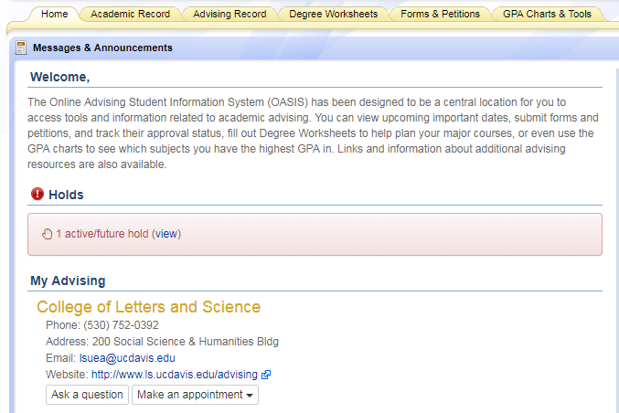
Holds
Notes:
Brenna/FYT

Slide 12
Advisor Responsibilities
In order to promote a supportive advising partnership, it is helpful to understand what you can expect when you meet with an academic advisor. Advisors are here to:
Listen carefully to your questions and concerns
Provide a safe and inclusive space
Guide your exploration of curriculum, graduation requirements, UC Davis policies and procedures, etc., and to help you make timely degree progress
Encourage, guide, and support you in developing goals and educational plans
Notes:
Brenna/FYT
College, campus and university requirements
Major requirements
Campus resources and campus procedures

Slide 13
Advisor Responsibilities (Continued)
Provide accurate and timely information
Connect you to university resources and services
Be accessible during advising hours by phone, email, or the advising messaging system
Maintain confidentiality in compliance with the Family Educational Rights & Privacy Act (FERPA)
Notes:
Brenna/FYT
College, campus and university requirements
Major requirements
Campus resources and campus procedures

Slide 14
Advisee Responsibilities
Students come from different backgrounds and educational experiences. Here at UC Davis, you are encouraged to pursue your academic, professional, and personal goals. Your role is to:
Take ownership of your education by attending class, regular advising appointments, instructor office hours; familiarize yourself with your degree requirements and plan your courses accordingly
Regularly utilize online academic tools such as OASIS, My Degree, Canvas, Schedule Builder, Campus Email, and the MyUCDavis Message Center
Notes:
Brenna/FYT
Information in your handbook and in the General Catalog and L&S website

Slide 15
Advisee Responsibilities (Continued)
Prepare for advising meetings ahead of time by familiarizing yourself with academic requirements, drafting a first year academic plan, formulating questions, and answering any preparatory questions prior to your appointment
Ask for help when you need it. Show initiative by making use of campus resources (e.g. Student Academic Success Center; Student Health & Counseling Services; Residence Hall Advising Team; Student Disability Center)
Explore, reflect on, and identify your academic, professional, and personal goals
Notes:
Brenna/FYT
Information in your handbook and in the General Catalog and L&S website

Slide 16
TRUE or FALSE?
I should read the mandatory advising hold information carefully to understand when and how I am required to meet with my major advisor.
Notes:
TRUE
Give Prize
Brenna/Laura end

Slide 17
FERPA
Family Educational Rights and Privacy Act
A federal law designed to:
Protect the privacy of student education records
Establish the right of students to inspect and review their education records
Each office handles FERPA differently
At Orientation: Guests are not allowed in advising spaces
This is your choice if you want a guest present
Waiver must be signed
Notes:
Beth/Tracy – “Now that you’re in college, you are responsible for your own education and we respect that and your right to make your own academic decisions. Also, Federal Law requires that your student information is kept private.”
Edit: As we’re all thinking about advising, one thing that you all should know about is FERPA, Family Educational Right and Privacy Act. It is a Federal law that requires student academic information to be held confidential; therefore, any academic related conversations you have with any of those advisors, will remain confidential. Only authorized personnel are given access to such student information (unless given permission by the student, parents do not have access).
Every office handles FERPA differently. At orientation, guests of students are only allowed to be in an advising space if a waiver has been signed by the student.

Slide 18
Communication is Critical
Read your UC Davis email – official means of communication
Check your myucdavis Message Center – official, secure means of communication
Use the Online Advising Student Information System (OASIS)
Notes:
Beth/Tracy
We can see whether or not you’ve read messages in the Message Center!
*Adding context about why UC Davis email is important and what functions it has(canvas updates sent here, professor announcements, and advising communication)* Bookmarking UCD email to browser/have it be a home page. Check at least daily. Keep it separate from personal email.

Slide 19
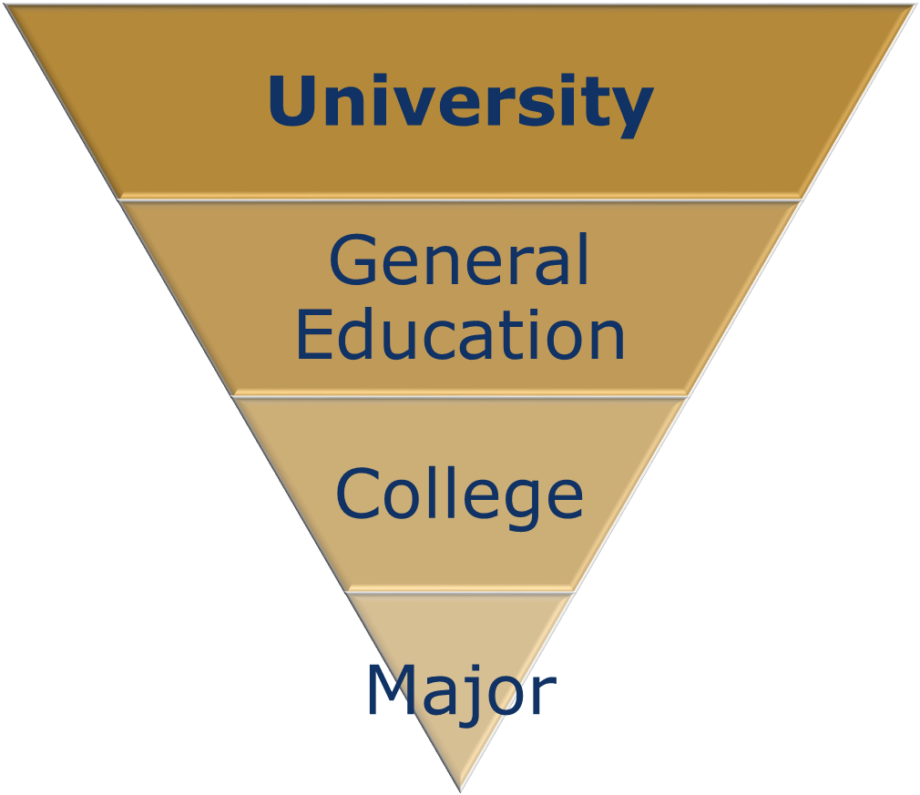
Graduation Requirements
Notes:
Beth/Tracy to introduce “we are now going to get into the nitty gritty details of your degree so you know what is required for graduation.

Slide 20
DEGREES IN THE COLLEGE OF LETTERS & SCIENCE
Bachelor of Arts (A.B.)
Bachelor of Science (B.S.)
Bachelor of Arts & Science (B.A.S.)
Notes:
Beth/Tracy

Slide 21
University and General Education Requirements
American History & Institutions
Scholarship
Residence Requirement
Unit Requirement
General Education
First Year Aggie Handbook pages 2-6 (Transfer Student Info: Page 4)
Notes:
Beth/Tracy
Need to expand info on ELWR & AHI details Refer students to the Orientation website

Slide 22
University Requirements
American History and Institutions
CA high school U.S. History or Civics
Scholarship Requirement
Minimum 3 quarters and 35 of the final 45 quarter units must be taken at UC Davis
Approved transferable community college course
Maintain minimum overall UC GPA of 2.00
Residence Requirement
Approved UC Davis course
Notes:
Beth/Tracy

Slide 23
Unit Requirement = 180 total units
Full-Time Student & Minimum Progress
15 units per quarter
45 units per year for 2 years (assuming you came with 90.0 transfer units)
12 units per quarter
Required for financial aid & to live in Student Housing
Expected Progress
New students complete 12-15 units in first quarter
Notes:
Brenna/Tracy
Explain Minimum Progress and that it calculate at the end of every quarter and they need a constant average of 12 units per quarter.

Slide 24
TRUE or FALSE?
Transfer students may have some remaining lower-division course requirements when they start at UCD.
Notes:
True

Slide 25
Intersegmental General Education Transfer Curriculum (IGETC)
IGETC satisfies L&S requirements for:
General Education (except for English Composition)
Foreign Language (Bachelor of Arts)
Area Breadth (Bachelor of Science)
Partial IGETC = Additional GE courses needed
Confirm receipt of IGETC with our office
TAG does not necessarily = GE complete
Notes:
How many from CCC?
How many think they have completed IGETC?
Explain how to get IGETC to UEA…

Slide 26
General Education Requirement (GE)
Most transfer students bring transferrable and equivalent classes in that satisfy various parts of the GE Requirement but not necessarily the entire requirement.
Some transfer students have satisfied the entire GE Requirement via IGETC.
All transfer students should understand what the GE Requirement is and their options to satisfy it.

Slide 27
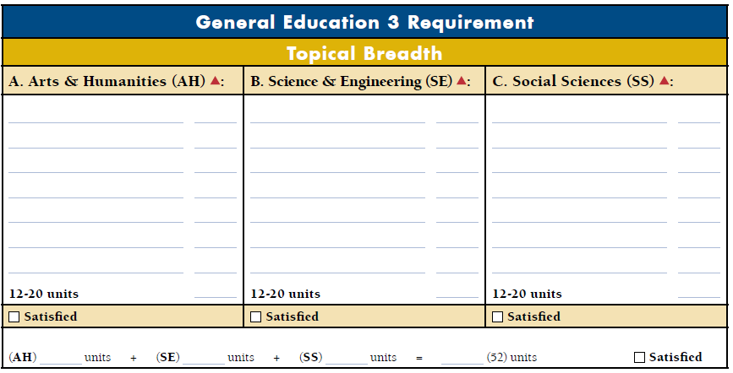
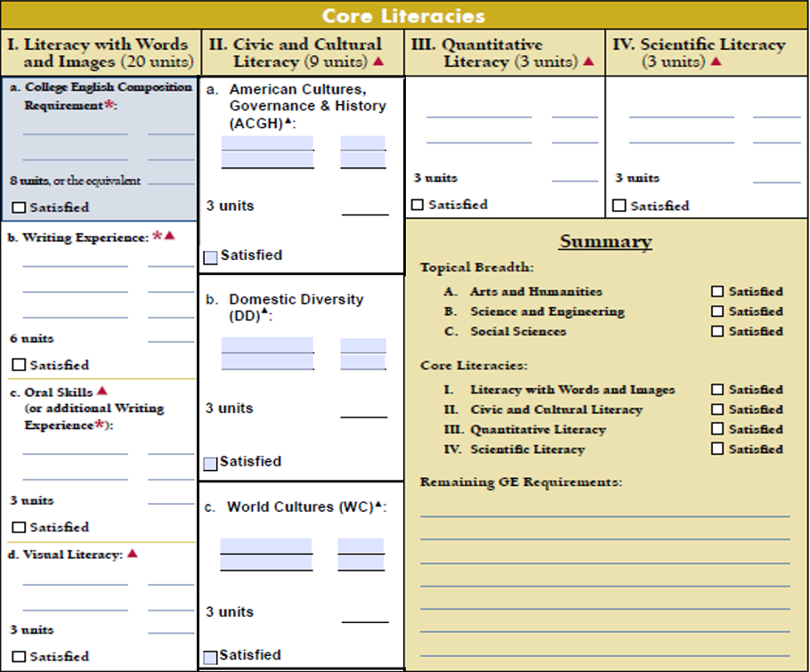
1
1
Topical Breadth
2
2
Core Literacies
Pg. 6
Notes:
Brenna/FYT
One way to remember the double dipping rule is “Yes Up and Down, No Left and Right”. Show the head shaking and nodding pneumonic to help emphasize the double dipping rule.
For example, History 17B has GE credit for both AH and SS, but I can only count it in one box in Topical Breadth
It also has credit for ACGH, DD, and WE. I can only choose one of these categories to put it in in Core Literacies

Slide 28
Topical Breadth
Requires 52 units total
Notes:
Brenna/FYT
Topical breadth, the top part of the chart, is broken up into 3 areas: Arts & Humanities, Science & Engineering, and Social Sciences. You need to have 52 units in order to complete Topical breadth, with a minimum of 12 and no more than 20 units in each box. Any combination of units that get you up to 52 units and has at least 12 in each box will satisfy this part.

Slide 29
Core Literacies
Requires 35 units total
I. Literacy with Words or Images (20 units)
II. Civic and Cultural Literacy (9 units)
III. Quantitative Literacy (3 units)
IV. Scientific Literacy (3 units)
Notes:
Brenna/FYT
Next is core literacies and it’s broken up into four different categories. The first category, literacy with words or images, requires 20 units to complete. The second category, Civic and Cultural literacy needs 9 units. Quantitative and Scientific literacy require 3 units each. So you need 35 units total for the core literacies.

Slide 30
College Requirements
English Composition
Lower Division
UWP 1, ENL 3, COM 1, 2, 3, 4 or NAS 5
Upper Division
UWP 101, 102, or 104
Foreign Language
15 unit equivalent (Bachelor of Arts only)
SAT, AP, IB, Placement Test can satisfy
Community college course equivalent can satisfy
Certified full IGETC can satisfy
Natural Science and Mathematics
90 units in Natural Science and Mathematics (Bachelor of Science only)
Satisfied by certified full IGETC
Upper Division Units
64 Upper-Division units (courses numbered 100-199)
Notes:
Brenna/FYT

Slide 31
Intersegmental General Education Transfer Curriculum (IGETC) - more
IGETC does NOT satisfy English Composition
Upper-division component cannot be completed at community college
Must earn 90 units before enrolling
Recommend completing this year
UWP 101, 102, or 104 with C- (or P) grade or better or “Pass” the Upper-Division Composition Exam
Offered each quarter during the academic year
PREREQUISITES STRICTLY ENFORCED

Slide 32
TRUE or FALSE?
At the end of each academic year, UC Davis students have to successfully complete an average of 12 units per quarter to meet the minimum progress requirement.
Notes:
True

Slide 33
Re-cap: Non-Major Requirements for transfer students to focus on
English Composition required for both the Bachelor of Arts & Bachelor of Science
(Upper-Division Requirement= UWP 101, 102, 104 or “Pass” the English Composition Exam)
Minimum of 180 total units (64 upper-division units: #100-199) needed for degree completion
Minimum Progress Requirement: 12 units per quarter; Expected Progress: 15 units average per quarter
Foreign Language proficiency required for a Bachelor of Arts, if not already satisfied
90 units of Natural Science and Mathematics required for Bachelor of Science – Area Breadth Requirement, if not already satisfied

Slide 34
TRUE or FALSE?
IGETC satisfies all L&S requirements.
Notes:
FALSE – IGETC does NOT satisfy the English composition requirement – upper division composition CANNOT be satisfied at a community college.
Beth ends

Slide 35
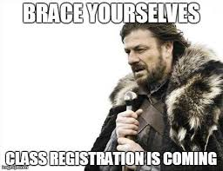
FIRST QUARTER PROGRAM PLANNING
Notes:
Brenna/FYT
No need to panic. We’ll be there! Write some things down now as we go through the following tips. Reminder – experts are available to help you tomorrow in our office 9-11:30am (unless you’re already assigned).

Slide 36
Tips for Success - Scheduling
How Many Courses?
Full-Time & Minimum progress = 12 units/quarter
Expected Progress = average 15 units/quarter
15 units for Fall (pay attention to add/drop deadlines)
“Carnegie Rule”
Notes:
Laura/Brenna start again, slides 34-40

Slide 37
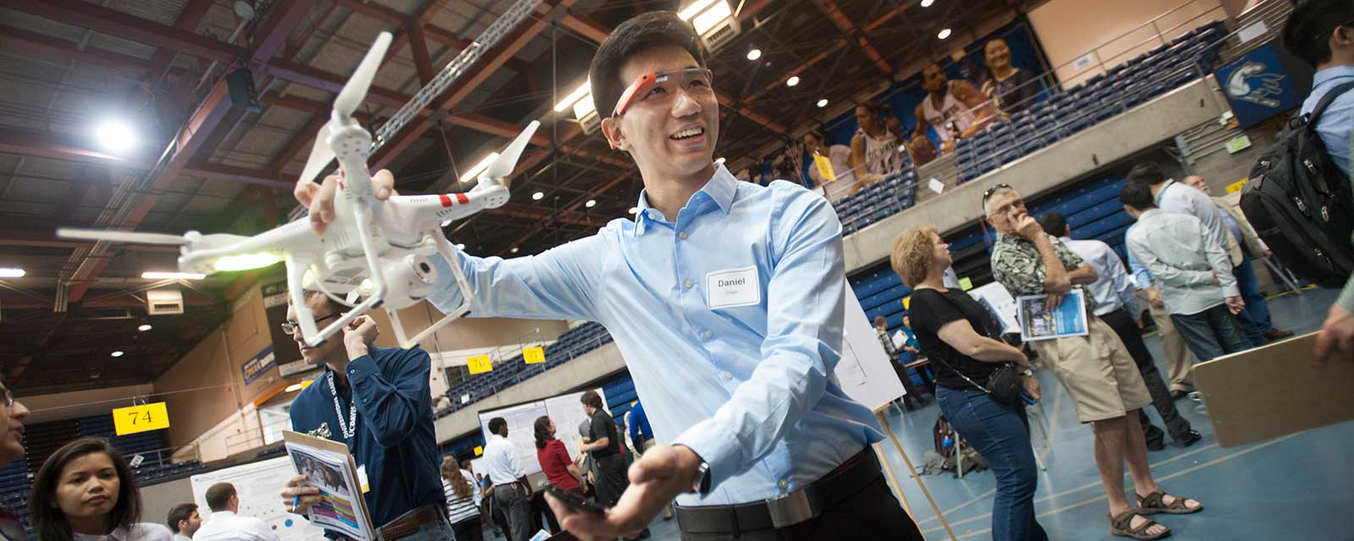
First Quarter Scheduling Tips
Courses for your major
Remaining GE
English Composition
Upper division electives? Courses for a minor?
Avoid duplication of credit: Do not take anything that sounds “familiar”
Do not attempt to take a course if you do not have the prerequisite completed

Slide 38
Quiz!
How many upper-division units do you need to graduate?
Notes:
Brenna/FYT

Slide 39
Placement Exams
Mathematics
Must take Math placement if planning MAT 12, 16A, 17A, 21A.
Chemistry
Must place into CHE 2A via SAT/ACT Math, SAT/AP Chemistry, ALEKS, Placement Exam, or WLD 41C.
Foreign Language
Take the placement exam to continue in a language and/or satisfy the Foreign Language requirement.
Notes:
Brenna/FYT

Slide 40
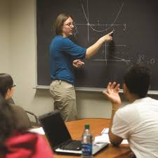
SCHEDULING TIPS: MATH & CHEM
Do you need mathematics and/or chemistry courses for your major or pre-health requirements? Do you have some lower-division requirements remaining?
Yes? See pages 16-21 in your First Year Aggie Handbook and register for the appropriate class
Notes:
Brenna/FYT

Slide 41
Success in L&S
Maintain a GPA of at least a 2.00 each quarter
“C-” is under a 2.00
Follow the “Carnegie Rule” for study time
Complete at least 12 units per quarter
Familiarize yourself with the General Catalog (catalog.ucdavis.edu) and your academic advisors
Notes:
The Carnegie Rule is 2-3 hours of study time for each hour spent in class.

Slide 42
Additional Messages
ROTC
Health Professions Advising
Notes:
Beth/Tracy – The ROTC and HPA offices asked us to make sure you all know they are excellent resources for new students on campus. I’ll share a little information about each.

Slide 43
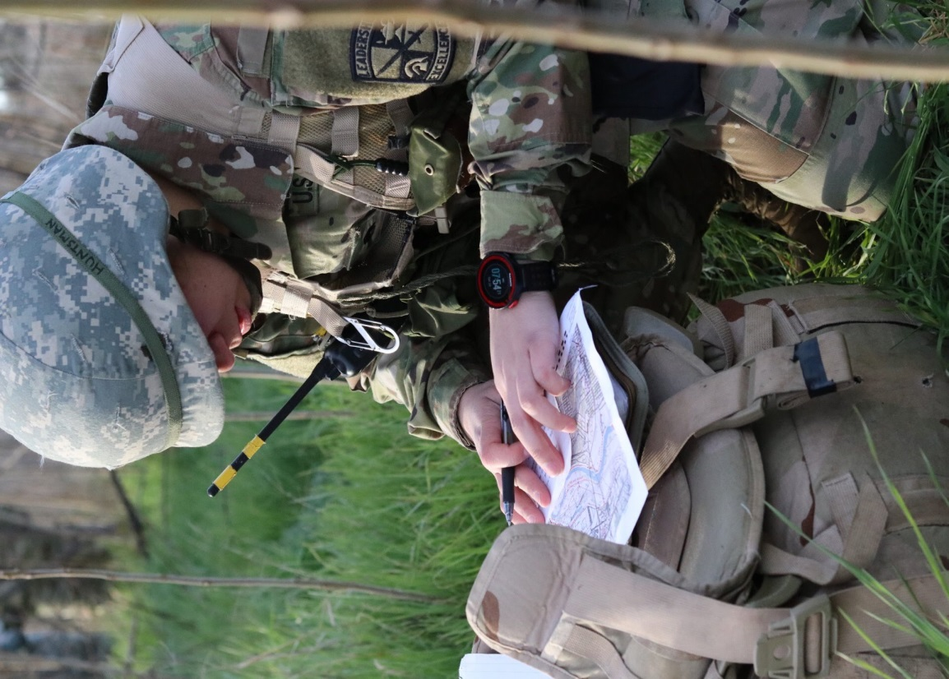
Army Reserve Officers’ Training Corps (ROTC)
Academic classroom and hands-on university leadership program
4 year program divided into two parts, Basic Course & Advanced Course
Looking for Scholar-Athlete-Leaders
2-3 Year Campus Based Scholarships (eligibility required)
Can join as an undergraduate Freshman, Sophomore or Junior
New Cadet Orientation Sept. 21st 9am in 150 Hickey Gym
https://militaryscience.ucdavis.edu/
For more information: ucdavisrotc@gmail.com; 530-752-7868
Notes:
California Polytechnic State University - San Luis Obispo
California State University - Fresno
California State University - Fullerton
Biola University
Cerritos College
Chapman University
Cypress College
Fullerton College
Golden West College
Mount San Antonio College
Orange Coast College
Rancho Santiago College
Vanguard University
Whittier College
Claremont-McKenna College
Azusa Pacific University
California Baptist University
California State Polytechnic University, Pomona
California State University - San Bernardino
Chaffey College
Citrus College
Harvey Mudd College, Claremont
Loma Linda University, Loma Linda
Mount San Antonio College
Occidental College
Pitzer College
Pomona College, Claremont
Scripps College, Claremont
University of California at Riverside, Riverside
University of La Verne
University of Redlands, Redlands
San Diego State University
California State University San Marcos
Grossmont College
Mesa College
Mira Costa College
Miramar College
Palomar College
Point Loma Nazarene College
Southwestern College
University of California - San Diego
University of San Diego
Santa Clara University
Foothills College
Mission College
San Jose State University
Stanford University
West Valley College
University of California - Berkeley
California State University East Bay
Saint Mary's College
Mills College
University of California - Davis
California State University - Sacramento
Simpson University
University of California - Los Angeles
California State - Los Angeles
Loyola Marymount University, Los Angeles
Pepperdine University
The Master's College
National University
University of California - Santa Barbara
California State University Channel Islands
Westmont College
Santa Barbara City College
University of San Francisco
University of Southern California
California State University - Dominguez Hills
California State University - Long Beach
University of California - Irvine

Slide 44
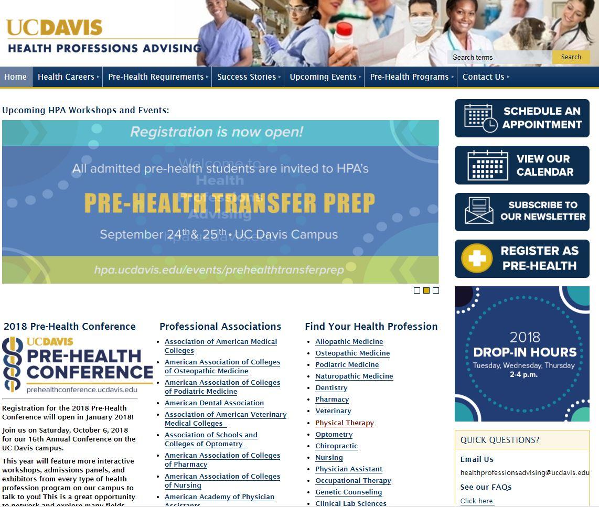
Health Professions Advising
https://hpa.ucdavis.edu
Notes:
Beth/Tracy – how many of you are interested in a health-related career? Good news! We have a robust health professions advising office here to support you from your first year through admissions into the professional school of your choice. This office serves students from all majors. First step is to explore the website – take a picture or write this down: hpa.ucdavis.edu.

Slide 45
“UCD Transfer Student Experience”(video)
Notes:
Beth/Tracy
We’d like to end with a video that showcases the experiences of some of our current transfer students, https://youtu.be/_U2f6IZsmIQ

Slide 46
To UC Davis and the College of Letters and Science!
WELCOME
Notes:
Beth/Tracy
Once again, we’re so glad you’re here! Welcome to the College of Letters and Science! We’ll see you tomorrow at course registration.

