Slide 1
Veterans Success Center Orientation 2018

Slide 2
Agenda
Welcome
Introductions VSC Staff
Introductions to VSC
DSVO
VA/State Benefits

Slide 3
Mission
The Veterans Success Center (VSC) at UC Davis is committed to providing services to the student veterans, service members and dependents of the Armed Services. We aspire to foster academic excellence of the whole student, from the beginning and beyond, while creating an environment of learning, networking, engagement, diversity and inclusion. We provide students a welcoming space, professional and peer advising, guidance with educational benefits and engagement opportunities that span the university and the larger Davis community.

Slide 4
What Does The VSC Have For You?
Veterans Success Seminar
Computer Lab With Printing
Community Counselor
Weekly Networking
Peer Advisors
Tutoring
VA Certifying Official
VA Advisor
Work Study Positions
Study Room
Lounge/Kitchen
Day Use Wall Lockers
Social events

Slide 5
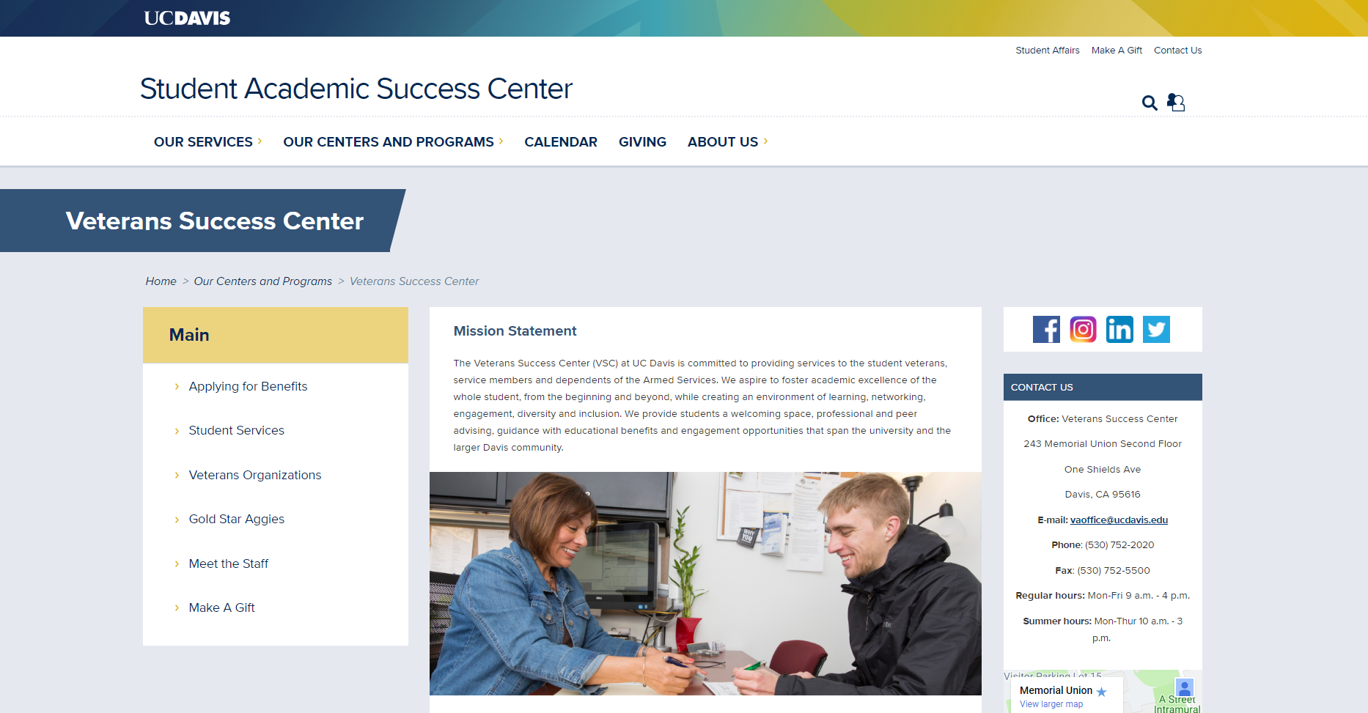
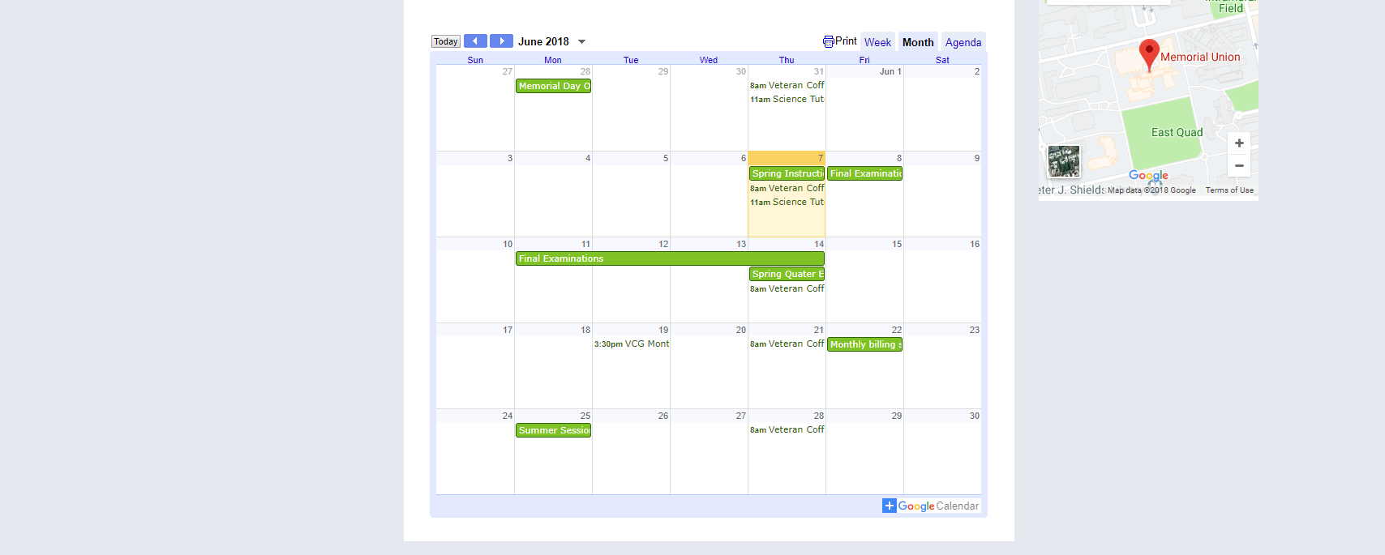
Stay Informed
veterans.ucdavis.edu
Calendar
Resources
Benefit updates
Forms

Slide 6
VET/DEP VSC Orientation
Veterans: 21 Sep, 2018
114 South Hall
7:30 – 2:00
Dependents: 25 Sep, 2018
114 South Hall
1:00 – 3:00

Slide 7
Veterans Strategies for Success
The course is both didactic and experiential. It is designed to provide a deeperunderstanding of the role of a research university and academic culture. Students will sharpen critical thinking, reading and writing skills, as well as strategies to cultivate relationship with faculty and other students. Students will refine their strategies for goal setting, time management, and academic planning, while being introduced to campus resources and opportunities beyond the classroom. Students will also prepare themselves for post graduation in job placement prep or graduate school prep. Information will be shared through lectures, reading, discussion and group exercises.
Class Number: 198-001
CRN 20615

Slide 8
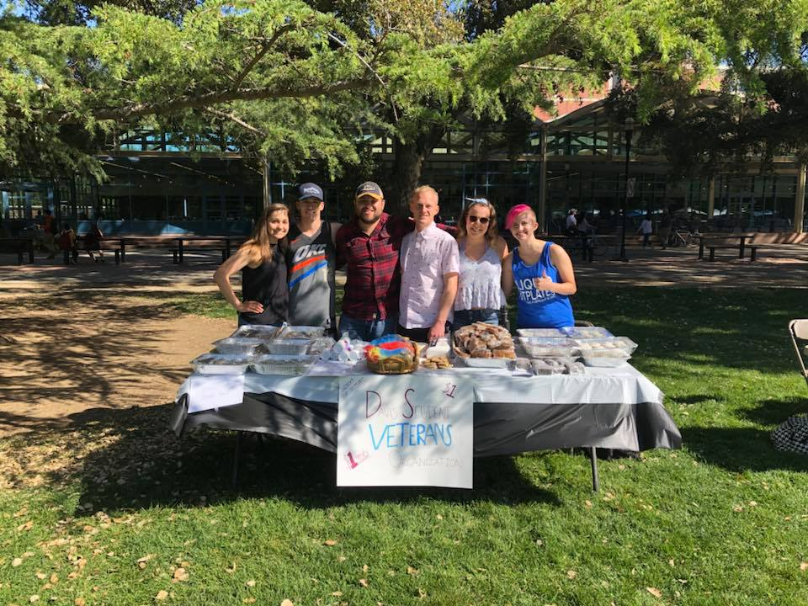
Davis Student Veterans Organization (DSVO)
Who can get involved:
→ Service Members
→ Veterans
→ Dependents
→ Military Supporters
What do they do:
→ Network
→ Socialize
→ Advocate
How to get involved:
→ Aggie Life (https://aggielife.ucdavis.edu/organization/davis-student-veteran-organization)
→ Facebook (@DavisStudentVeteran)

Slide 9
VA EDUCATION BENEFITS OVERVIEW

Slide 10
UC Davis Students Receiving Benefits
Currently our office serves approximately 800 students, including veterans, reservists, and dependents of veterans
165 veterans - 627 dependents
Undergraduates
Graduate student
Law School
Grad School of Management
Medical School
School of Veterinary Medicine
School of Nursing
Medical Residency Programs at UCD Medical Center

Slide 11
POST 9/11 GI BILL
The Post 9/11 GI Bill (CH 33) active duty members who served on active duty after 9/11 AND transferred their benefit to their dependents.
Eligibility range from 40-100%, based on length of active duty service after 9/11.
Pays 100% (or eligibility level) of Tuition and fees at public institutions in-state fees (Tuition and Fees is paid directly to the school)
Pays BAH, $2121/month
(BAH is paid to recipient (a month in arrears) if eligible for kicker, it is paid with BAH)
Book stipend, $1000/year (Book Stipend is paid to recipient in the beginning of the quarter, $500 in fall and $500 in winter)

Slide 12
APPLYING FOR GI BILL
Documents Required
Certificate of Eligibility
(New COE required every year)
22-5495
Academic Plan Form
(APF required every quarter)

Slide 13
VA LICENSES, TESTS AND EXAMS
CH 33 students may be reimbursed for one licensing or certification test. Students are reimbursed the cost of the test, the reimbursement can not exceed $2,000. The test must be approved for VA benefits.
Individuals may be reimbursed for multiple licensing and certification exams. One month of entitlement will be charged for each $1,759.08 paid beginning August 1, 2015. The test must be approved for VA benefits.
VA students can apply for test fee reimbursement by completing and submitting an Application for Reimbursement of Licensing or Certification Test Fees.
Attach a copy of their test results to the application. If test results are not available they can attach a copy of their license or certification and a payment receipt. Test fee reimbursement can be paid for each test for which reimbursement is claimed and these documents are submitted.

Slide 14
Tutorial Assistance
Veterans, reservists and dependents receiving educational benefits are eligible for tutorial assistance.
The VA will pay up to $100 per month for tutoring
$1,200 maximum, the first $600 has no charge to entitlement).
For CH 33 recipients, there is no charge to entitlement for the $1,200 maximum benefit.
Ch 1607 is not authorized for tutorial assistance at this time.

Slide 15
Chapter 35: Dependents Educational Assistant Program
Eligibility Requirements:
Veteran parent is 100% totally and permanently service-connected disabled or service-connected deceased
Benefit
$1041/month in school
Following months w/ school breaks the amount will be lessened (i.e. winter and spring break)
NEW: 36 months of entitlement to age 26

Slide 16
ADVANCE PAYMENT Chapter 35
Payment for the first and second month of the quarter in advance
An advance payment can be made if:
There is more than 30 days between terms
The student is enrolled at least half-time
VA receives the advance payment request at least 30 days before the enrollment period
Payment is sent to the school

Slide 17
ACADEMIC PLAN FORM (APF)
For Ch. 33 & 35 ONLY
VA Requires all students receiving federal educational benefits to have an Academic Plan Form on file.
APF must be filled out with courses for all three quarters and signed by an academic advisor (not a student peer advisor). Elective or Psy-xx is not accepted courses.
APF must be updated quarterly if courses change and signed again by academic advisor.

Slide 18
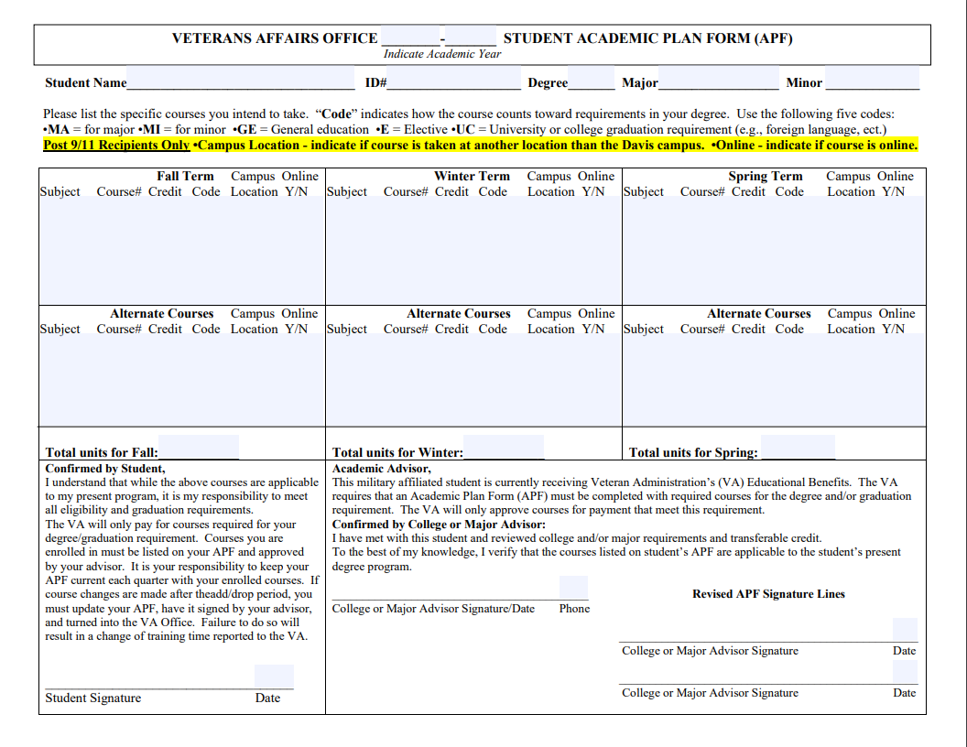

Slide 19
California Veterans Fee Waiver Program
Dependents of service-connected disabled or deceased veterans
Waiver of the Student Services Fee and Tuition Fee (and profession school fee) for students in professional school.
Required documents:
Application
Copy of previous year’s tax return or Statement of Non-filing from either the IRS or FTB
Birth certificate
All documents must be submitted to Veteran County Office
The certificate of eligibility for that academic year then needs to be given to us

Slide 20
California Veterans Fee Waiver Program
What does the College Fee Waiver Program for veteran dependents cover at UC Davis?
It waives the tuition and student service fee for undergraduate and graduate students, and the professional degree supplemental tuition for professional school students.
It does not waive the campus-based fees; the student is responsible for these fees. Note: the Cal Vet Fee Waiver does not cover other expenses associated with attending UC Davis such as books, housing and parking.
Summer Sessions
The Cal Vet Fee Waiver waives the course fees. It does not waive the campus based fee; the student is responsible for this fee.
Study Abroad
The Cal Vet Fee Waiver waives the course fees only. Student is responsible for all other program fees.

Slide 21
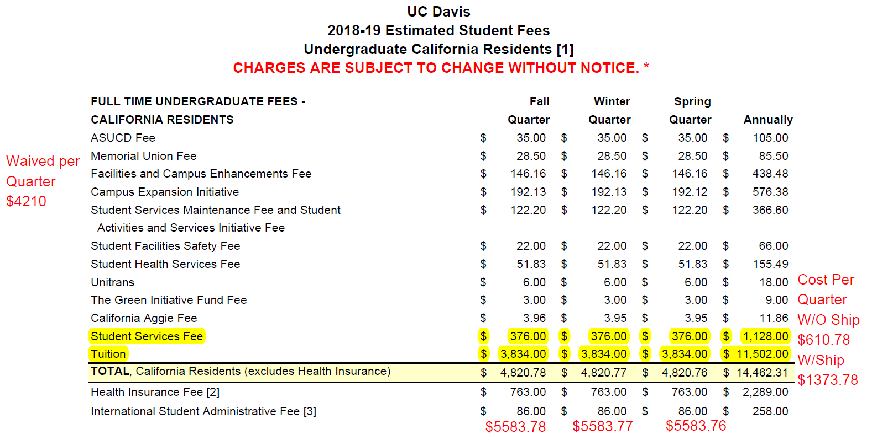
Cal Vet Fee Waiver Fees

Slide 22
Which Fees Are Waived at UC Davis?
The Tuition and Student Service Fee of $4210 is waived per quarter, for undergraduate and graduate students. For professional schools, it waives the Tuition, Student Service Fee, and the Professional Degree Supplemental Tuition. Check specific school for these amounts.
Which Fees Are Not Waived at UC Davis?
The campus based fees; the student is responsible to pay these fees by the fee deadline each quarter.
How Much Are the Campus Based Fees?
$1,349.49 per quarter - Undergraduates
This amount includes the Student Health Insurance Plan (SHIP) fee of $753.00, which can be waived if you have your own health insurance
Summer Sessions
The Cal Vet Fee Waiver waives the course fees. It does not waive the campus based fee; the student is responsible for this fee.
Study Abroad
The Cal Vet Fee Waiver waives the course fees only. Student is responsible for all other program fees.

Slide 23
California Veterans Fee Waiver Program
What programs are not eligible for the College Fee Waiver Program for Veteran Dependents?
Self-Supporting Degree Programs (SSDP) are not eligible to use the Cal Vet Tuition/Fee Waivers. These programs are not supported with state funds and are not subject to the state law regarding Cal Vet Tuition/Fee Waiver. SSDPs are mid-level graduate professional degree programs that do not receive any state funding support and cannot be subsidized by tuition or fees paid by students in state-supported programs.
University Extension programs or courses are not eligible to use the Cal Vet Tuition/Fee Waivers. These programs are not supported with state funds and are not subject to the state law regarding Cal Vet Tuition/Fee Waiver.

Slide 24
Questions?

Slide 25
Coordinator: Earl Raehsler
elraehsler@ucdavis.edu
Location: Memorial Union, Room 243
Regular Hours: Mon-Fri 9:00 am – 4:00 pm
Summer Hours: Mon-Thur 10:00 am – 2:00 pm
Phone: 530-752-2020
Fax: 530-752-5500
Email: vaoffice@ucdavis.edu

